Slide 1
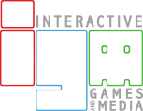
DRONE STEALTH
IGME 601.01: GAME DEVELOPMENT PROCESSES – S1 PITCH - TEAM C
Jiayi Jiang
Victor Shu
Mark DelFavero
Shantanu Jamble
Alabhya Maheshwari

Slide 2

GOALS
Make a game that explores a genre in ways that are less mainstream.
Put into practice the development processes we learn in class.
Practice good teamwork.
Notes:
By less mainstream we mean the Pure stealth play with a drone flying around
We Want to practice whatever we are learning in the class
We want to learn and understand how big project teams work in industry and try and implement that strategies for our project.

Slide 3
TARGET AUDIENCE
Drone enthusiasts
Control a drone
Modify the functions and performance of the drone
Stealth game fans
Plan route of stealth
Stick to the plan
Being vigilant to unexpected situations
Explorers
Explore the world
Notes:
The game is targeting at fans of stealth games, drone enthusiasts and explorers.
Fans of stealth games are obsessed with planning things, sticking to the plan and being vigilant to the environment and enemies. We want to provide such an experience to our target and potential audience. We want to make the missions in our game challenging. This means that the player needs a thorough plan to infiltrate the enemy base. The player may also need some maneuverability to pass through some parts of the level.
Drone enthusiasts include people who are interested in flying a drone in an open space and those who are dedicated to modifying the functions and performance of the drone. We want our game to attract both kinds of people. So, we are looking into the non-linear level design. We also want our level to have vertical complexity. In this way, we think those who like flying the drone can enjoy the experience of flying around. Also, we plan to introduce customizations of drones into the game. Players can install different tools on the drone to do a variety of things.
There are many open-world games on the market nowadays, and they attract many players because these players like to explore the world. We would like to target at these players too, and that’s another reason of making our levels non-linear

Slide 4
NICHE IN THE MARKET
The rareness of drone games
Maneuverability of the drone
Non-humanoid stealth game
Notes:
As drone games in the market are rare, our game can directly fill the niche. Even in games with drones, instead of laying emphasis on the maneuverability, the primary function of the drone is just marking enemies. Instead of that, we want our drone to do more things like hacking into computers, flying through detecting measurements, and taking pictures.
We also want to fill the gap in stealth games. In almost all stealth games, players control human beings to complete missions. Thus, the designs of these games mainly focus on the terrain. However, with a flying drone, we can have more possibilities. We want our levels to have more vertical complexity, which will give players a new experience of sneaking in.

Slide 5
SPECIFIC CHARACTERISTICS OF THE USERS
Thorough planners
Blueprint system
Customization fans
Modify their drones
Notes:
Then it comes to the specific characteristics of the users. Those people influence our game design.
The first is thorough planners. They like to make a thorough plan before playing the game. For these players, we plan to introduce a blueprint system. They can have a look at the blueprint of the target building, and then make a plan based on it before they start the mission.
The second is customization fans. They like to customize things. So, in our game, players will have the choice to decide which tool they want to install on the drone. With these customizations, players can modify their drones and find the most suitable way to achieve their goals.

Slide 6

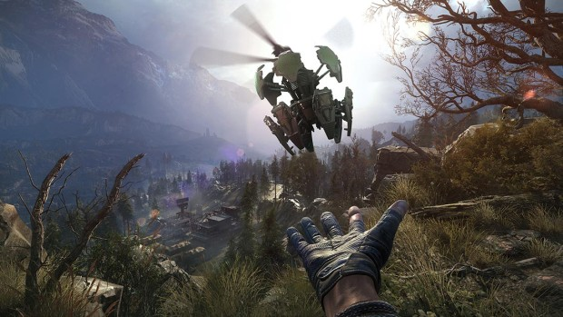
GAME TYPE
Single-player
Pure stealth game
Non-linear level design
Notes:
After analyzing the market and users, we decide to include some key points in our game.
First, It will be a single-player game, in which the player can fly the drone and make decisions whatever they want.
Second, It will be a pure drone stealth game. Players can control their powerful drone to complete stealth mission; and there will be very limited or even no combat element.
Moreover, we want to design non-linear levels with vertical complexity so that the player will have an open space to explore and find a unique path to sneak in.

Slide 7
CORE DOMAIN CONCEPTS
Player
Top Secret Information
Tools
Guards
Locks
Electrical Energy

Slide 8
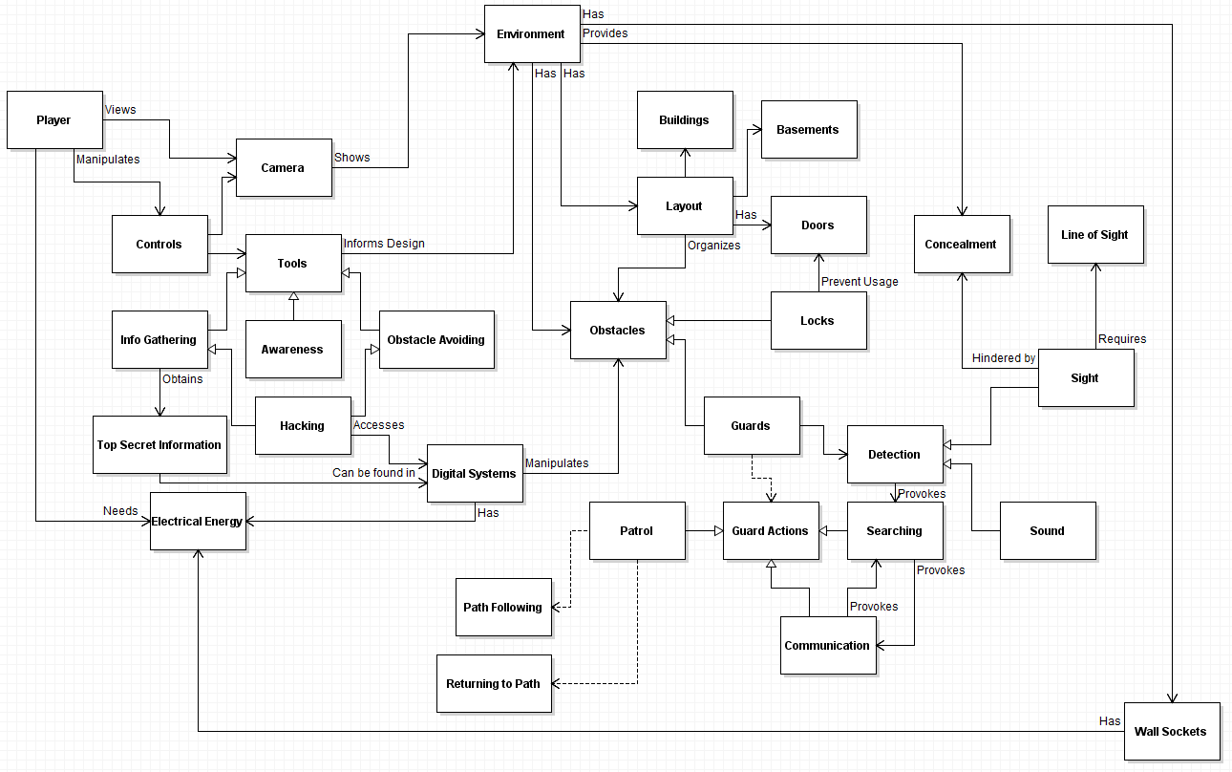

Slide 9
GAME FEATURES
360 degree maneuverability
Drone customization
Drone tools
Enemies
Security system
Challenging environmental obstacles
Energy systems

Slide 10
FEEDBACK AND QUESTIONS
?

